Slide 1
Measurement Standard Operating Procedure
Project: amazon
Part Name: ASSY, DEVICE, CARNIVAL
Part Number: 05-108353 Rev: 02
Prepared by: S. T. Pan Date: 2026/06/06
Checked: Y. H. Ning
制作: f2160112
Notes:
----- Meeting Notes (9/4/13 09:43) -----
add column for cpk vs in-process
remove datums

Slide 2
Contents
Contents | Note | Page
Revision History |  | Page 3
Summary |  | Page 4
Measurement Equipment | CMM, OMM, HG | Page 5~7
Fixture Structure |  | Page 8
Datum Establishment OMM1& Measurement Description |  | Page 9~11
Datum Establishment OMM2& Measurement Description |  | Page 12~13
Datum Establishment OMM3& Measurement Description |  | Page 14~15
Datum Establishment OMM4& Measurement Description |  | Page 16~17
Datum Establishment OMM5& Measurement Description |  | Page 18
Datum Establishment OMM6& Measurement Description |  | Page 19
Datum Establishment CMM1& Measurement Description |  | Page 20
Notes:
----- Meeting Notes (9/4/13 09:43) -----
add column for cpk vs in-process
remove datums

Slide 3
Revision History
Rev | Zone | Description Of Revision | APPROVED BY | DATE
01 |  | FIRST RELEASE | CARL | 2026/01/08
02 |  | UPDATE FAI06-1,FAI06-2,FAI11 | CARL | 2026/05/28

Slide 4
Summary
No. | SPC Callout | Nominal | +Tol | -Tol | Measurement Method | Description | Fixture No. | Drawing Location | Remark
FAI01 |  | 9.35 | 0.30 | -0.30 | OMM | Distance | / | S1D4
FAI02 |  | 91.50 | 0.20 | -0.20 | OMM | Length | / | S1C4
FAI03 |  | 3*21.10 | 0.20 | -0.20 | OMM | Width | / | S1B4 | W1,W2,W3
FAI04 |  | 2*0.21 | 0.10 | -0.10 | OMM | GAP | / | S1B3
FAI05 |  | 2*0.21 | 0.10 | -0.10 | OMM | GAP | / | S1B3
FAI06-1 |  | 9*0.05 | 0.10 | -0.10 | OMM | STEP | / | S1B2 | S2~S10
FAI06-2 |  | 3*0.00 | 0.10 | -0.10 | OMM | STEP | / | S1D1 | S1,S11,S12
FAI7 |  | 3*14.50 | 0.40 | -0.40 | CMM | Height | / | S1B2 | H1,H2,H3
FAI8 |  | 12*0.05 | 0.10 | -0.05 | OMM | GAP | / | S1D1 | G1~G12
FAI9 |  | 2*0.35 | 0.20 | -0.20 | OMM | GAP | / | S1C1
FAI10 |  | 2*0.35 | 0.20 | -0.20 | OMM | GAP | / | S1C1
FAI11 |  | 0.28 | 0.26 | -0.26 | OMM | Distance | / | S2C2
Notes:
----- Meeting Notes (9/4/13 09:43) -----
add column for cpk vs in-process
remove datums

Slide 5
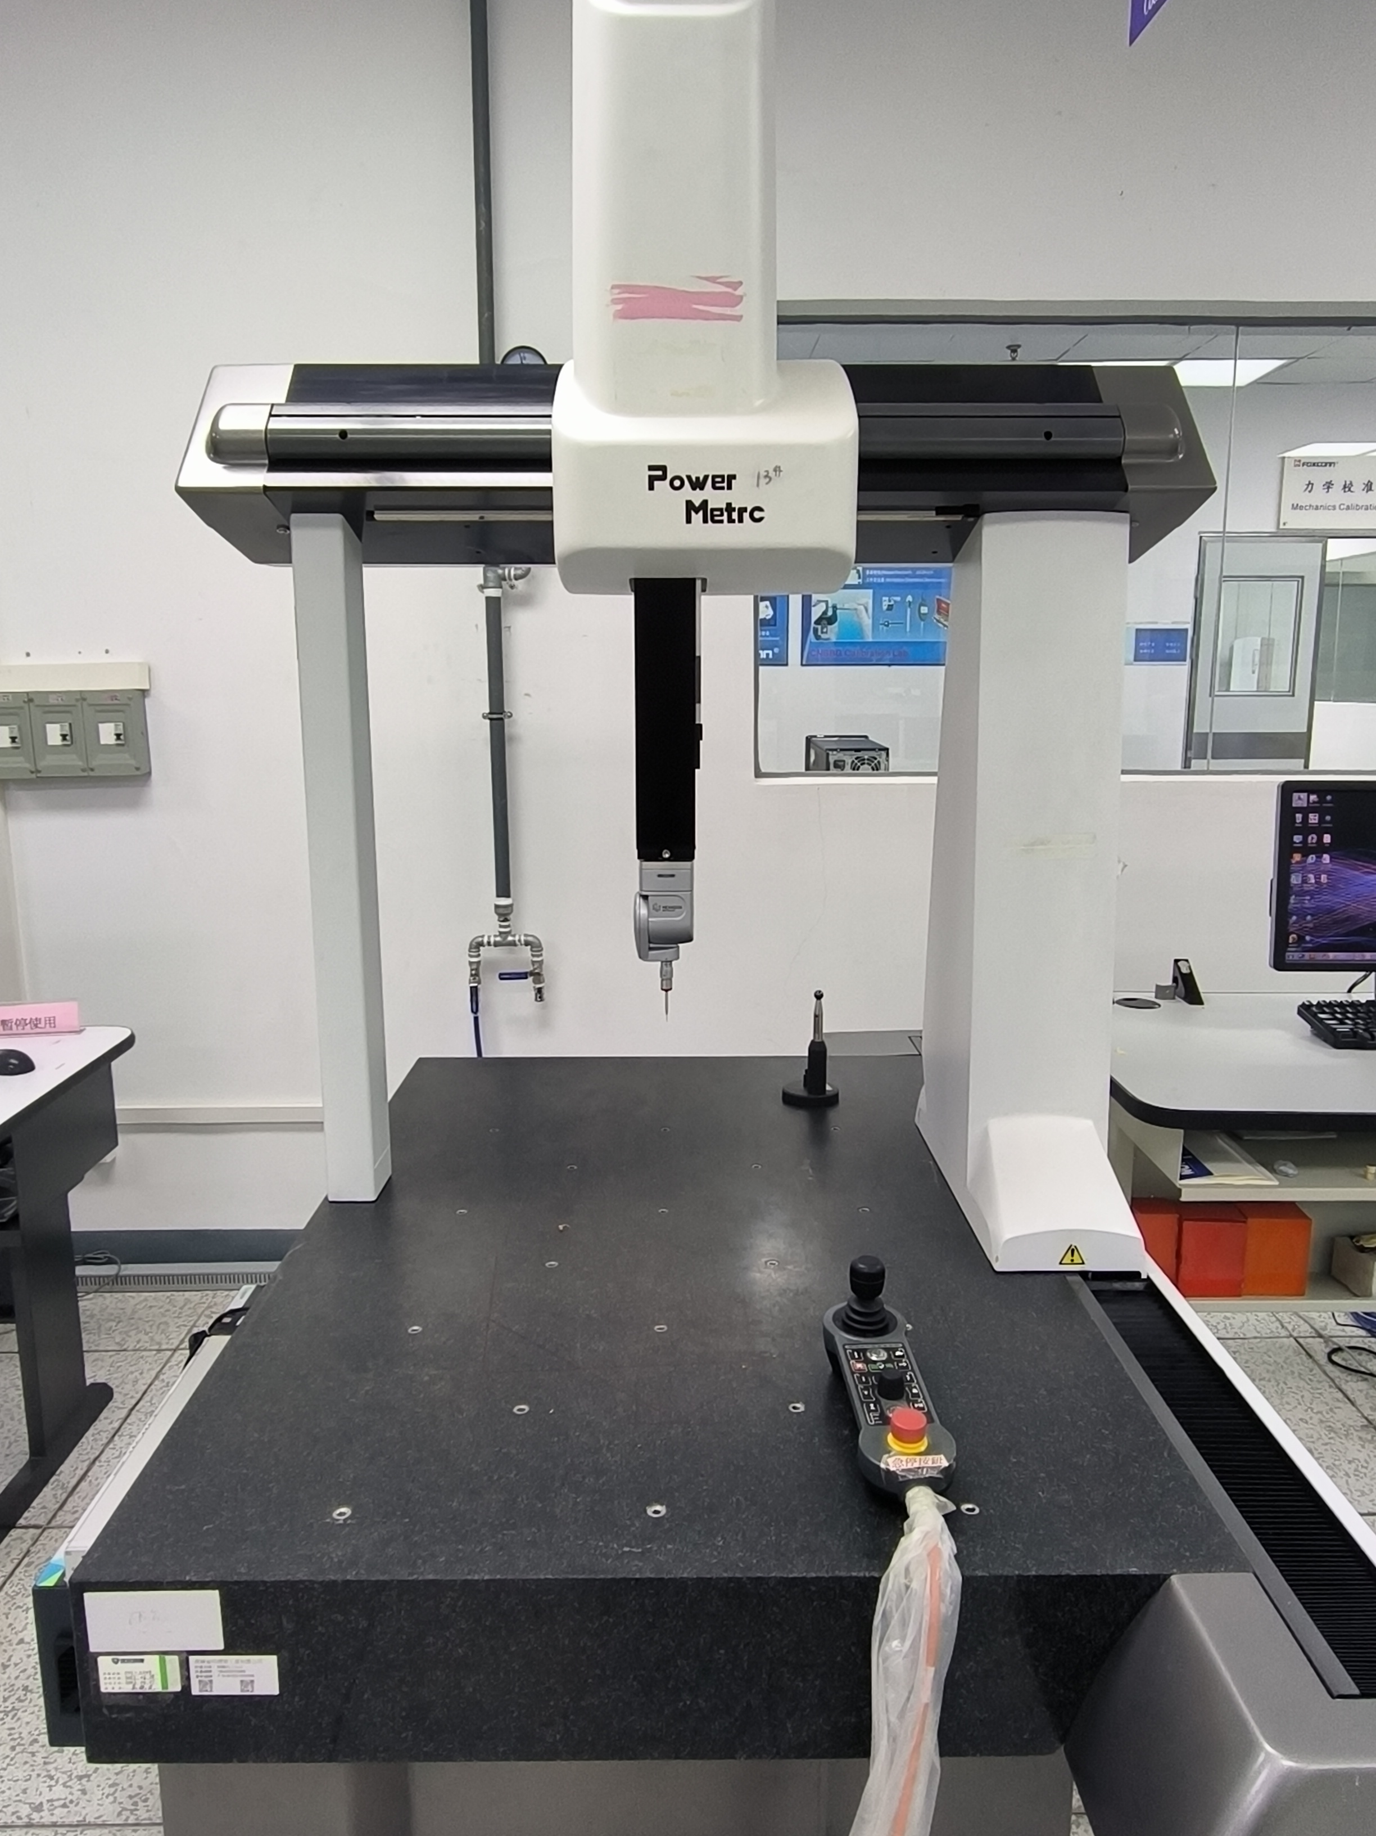

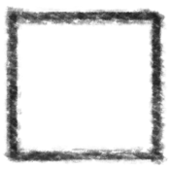
Measurement Equipment - CMM
Coordinate Measuring Machine(接触式三次元)
CMM MANUFACTURER: Hexagon
CMM MODEL: PM-T8106
PRECECISON: ±(2.8+L/300)μm
PROBE T1
PROBE MANUFACTURER: Renishaw
PROBE MATERIAL: Tungsten carbide
PROBE TYPE: Cylindrical needle
PROBE DIAMETER: Ø0.5x15.3mm
SHAFT LENGTH: 20mm
PROBE T2
PROBE MANUFACTURER: /
PROBE MATERIAL: /
PROBE SHAPE: /
PROBE DIAMETER: /
SHAFT LENGTH: /
NOTE: Select probe configuration based on measurement situations
Notes:
5

Slide 6
Measurement Equipment - OMM
Optical Coordinate Measuring Machine(影像三次元)
OMM MANUFACTURER: Foxconn
OMM MODEL: Power Metro 3000
MEASURING RANGE: X=300mm, Y=300mm, Z=200mm
MAX MAGNIFICATION: 3X (Screen Magnification: 90X)
PRECECISON: U_{1xy}:(1.5+L/333)μm; U_{1z}:(3.0+L/250)μm;
LIGHTING CONDITION: Ring Light, Profile Light, Coaxial Light
Lighting Condition
Notes:
6

Slide 7
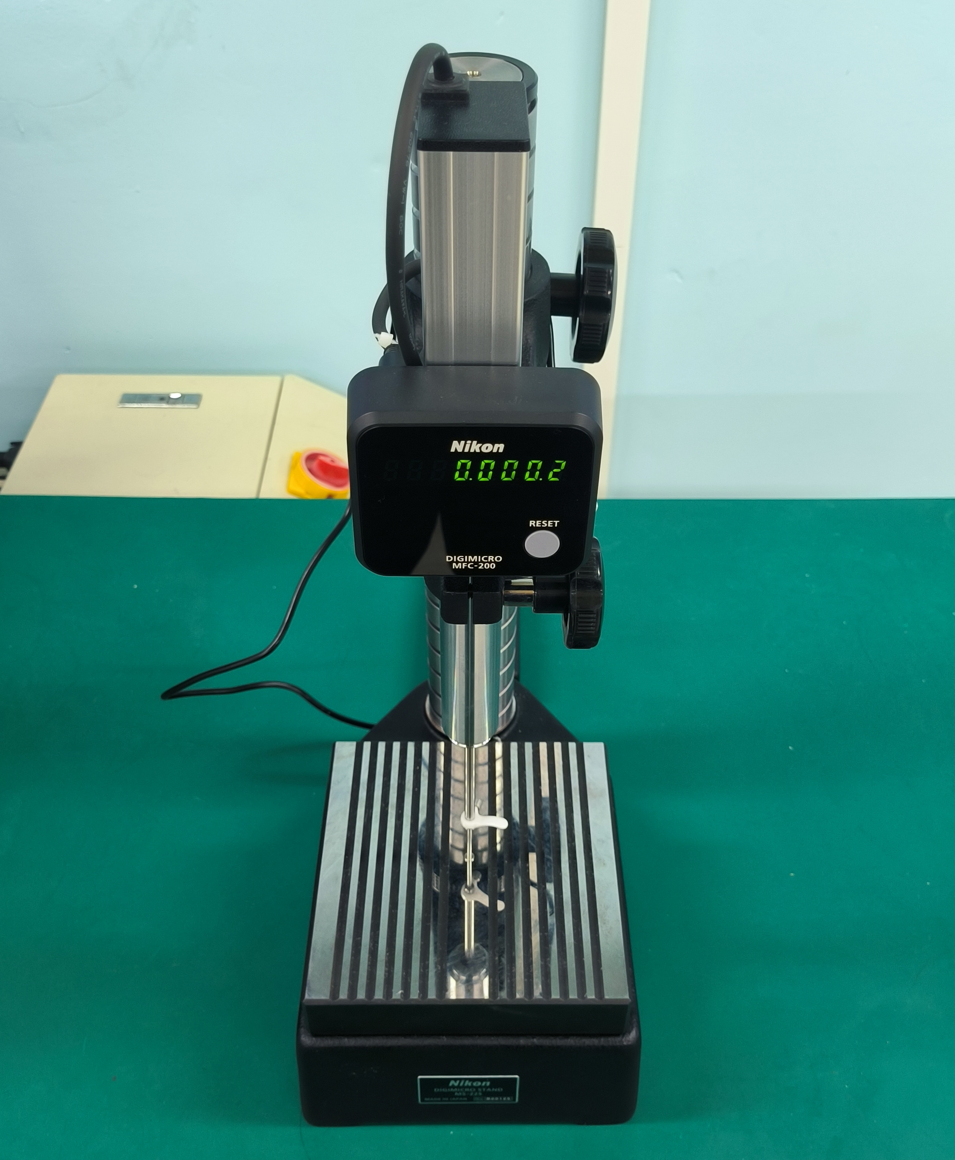
Measurement Equipment - HG
Height Gauge(电子高度计)
HG MANUFACTURER: Nikon
HG MODEL: MF-1001
MEASURING RANGE: 0.0001~100.0000mm
RESOLUTION: 0.0001mm
TOUCH FORCE: /

Slide 8
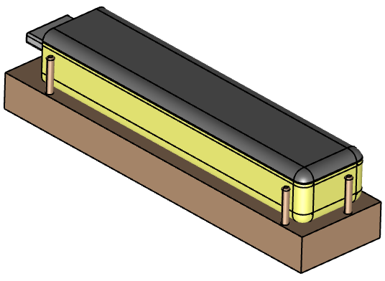
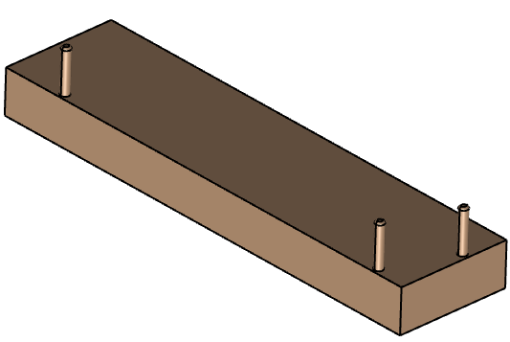
Fixture Structure
Fixture & Positioning method(夹具及定位方法):
1).樣品裝夾如下圖所示。
装夹前
装夹后
Notes:
8

Slide 9
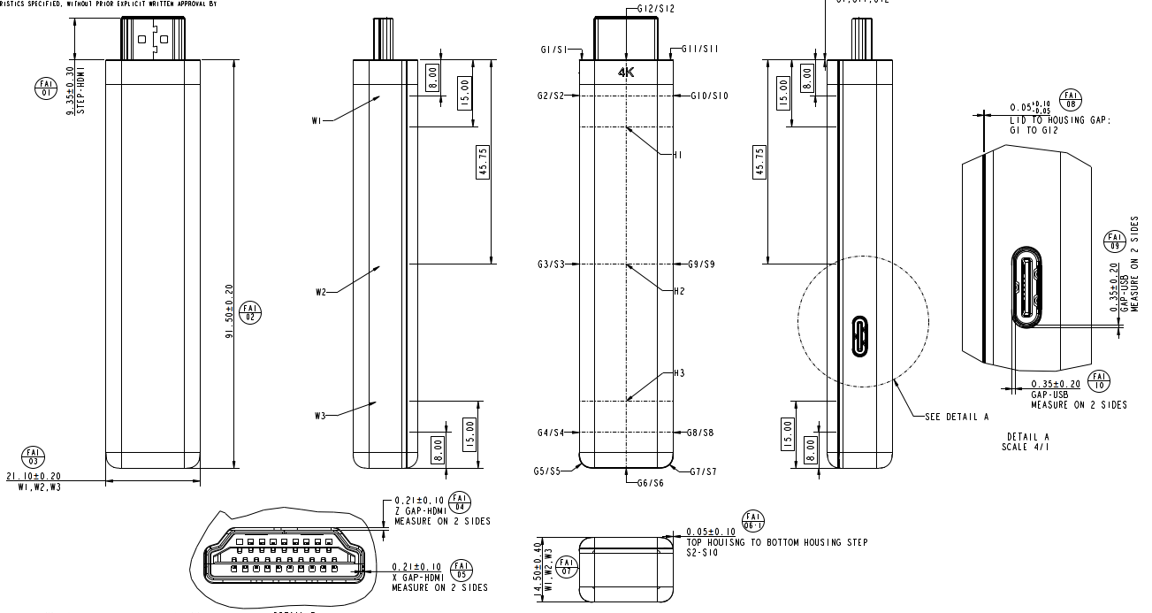
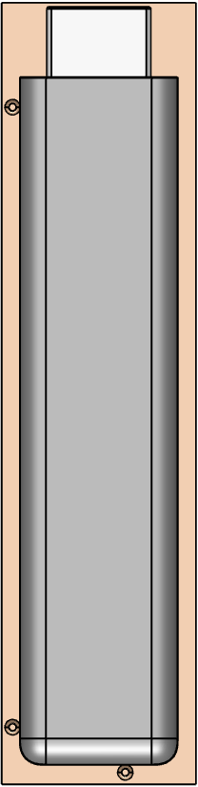

Datum Establishment
OMM Build Datum Alignment 1
Measurement equipment(测量设备): OMM
Clamping instructions(裝夾说明): /
Magnification/ Lighting condition(倍率/光源): 1x / Ring Light
Datum Setup(基准建立):
1.按照下(图1)所示装夹产品, 并放置于设备平台上。
2.在产品表面对焦取点测量平面PL1(Z1~Z4), 在产品边缘取点P1~P5。
3.P4&P2构建线L1, P5&P3构建线L2, L1&L2构建中线L3。
4.将PL1摆正Z轴, L3旋转至Y轴, 设定PL1为Z轴原点, 设定L3为X轴原点, 设定P1为Y轴原点。
P1
P2
P3
Z1
Z2
P4
Z4
P5
Z3
(图1)
Notes:
9

Slide 10
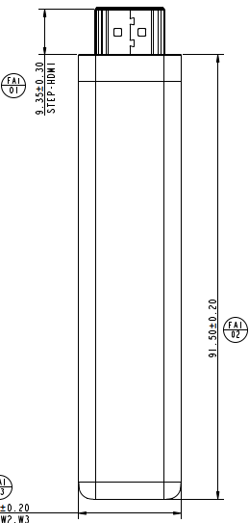
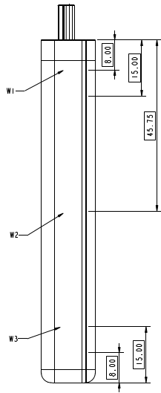

Measurement Description
No. | SPC Callout | Nominal | +Tol | -Tol | Measurement Method | Description | Fixture No. | Drawing Location | Remark
FAI01 |  | 9.35 | 0.30 | -0.30 | OMM | Distance | /
FAI02 |  | 91.50 | 0.20 | -0.20 | OMM | Length | /
FAI03 |  | 21.10 | 0.20 | -0.20 | OMM | Width | / |  | W1,W2,W3
Measurement equipment(测量设备): OMM
Magnification/ Lighting condition(倍率/光源): 1x / Ring Light
Measurement Datum (测量基准): OMM Build Datum Alignment 1
Measurement description(测量描述):
1).在X=0mm的位置取点P1, P6。
2).在Y=-8.00mm的位置取点P2, P3。
3).在Y=-45.75mm的位置取点P4, P5。
4).在P6的Y轴座标值+8.00mm处取点P7, P8。
5).FAI01: 输出P1的Y向座标值。
FAI02: 输出P6的Y向座标值。
FAI03-W1: 输出{P2&P3}的X向距离。
FAI03-W2: 输出{P4&P5}的X向距离。
FAI03-W3: 输出{P7&P8}的X向距离。
P1
POS | X | Y
P1 | 0 | /
P2 | / | -8.00
P3 | / | -8.00
P4 | / | -45.75
P5 | / | -45.75
P6 | 0 | /
P7 | / | P6.Y+8.00
P8 | / | P6.Y+8.00
P2
P3
P4
P5
P7
P8
P6
(图1)
Notes:
10

Slide 11

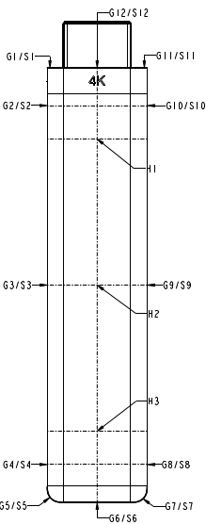
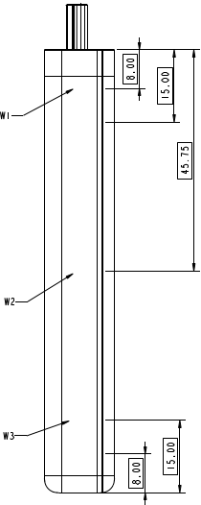
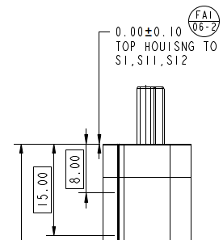

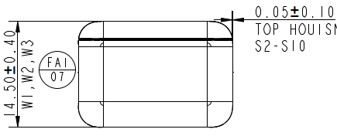

Measurement Description
No. | SPC Callout | Nominal | +Tol | -Tol | Measurement Method | Description | Fixture No. | Drawing Location | Remark
FAI06-1 |  | 0.05 | 0.10 | -0.10 | OMM | STEP | / |  | S2~S10
FAI06-2 |  | 0.00 | 0.10 | -0.10 | OMM | STEP | / |  | S1,S11,S12
Measurement equipment(测量设备): OMM
Magnification/ Lighting condition(倍率/光源): 2x / Ring Light
Measurement Datum (测量基准): OMM Build Datum Alignment 1
Measurement description(测量描述):
1.1).如下(图1)所示, 在S2处取点P1, P2。
1.2).FAI06-1-S2: 输出{P1&P2}的X向距离。
1.3).用相同方法测量S3, S4, S6, S8~S10, S1, S11, S12的位置。 。
2.1).将S4设为X原点, S6设为Y原点, OMM基准1旋转45度, 在
S5处取点P3, P4 。
2.2).FAI06-1-S5: 输出{P3&P4}的Y向距离。
2.3).用相同方法测量S7的位置。
S1
S12
S11
P1
P2
S2
S10
S2取点位置
S3
S9
y
x
P4
S4
S8
P3
S5
S6
S7
(图1)
S5取点位置
Notes:
11

Slide 12

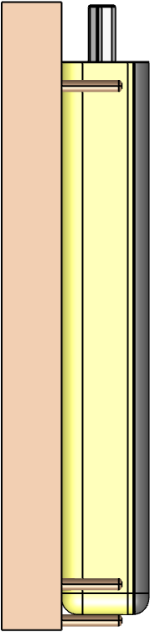
Datum Establishment
OMM Build Datum Alignment 2
Measurement equipment(测量设备): OMM
Clamping instructions(裝夾说明): /
Magnification/ Lighting condition(倍率/光源): 2x / Ring Light
Datum Setup(基准建立):
1.按照下(图1)所示装夹产品, 并放置于设备平台上。
2.在产品表面对焦取点Z1, 在产品边缘取点P1~P3 。
3.P1&P2构建线L1, 将L1旋转至Y轴, 设定Z1为Z轴原点, 设定L1为X轴原点, 设定P3为Y轴原点。
P3
P1, P2
P2
Z1
P1
(图1)
Notes:
12

Slide 13
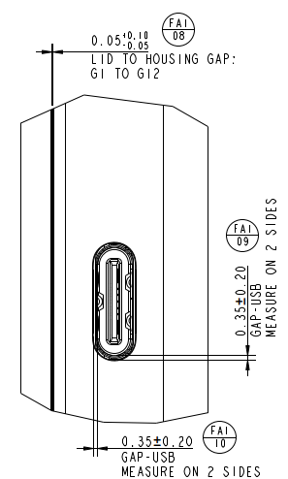
Measurement Description
No. | SPC Callout | Nominal | +Tol | -Tol | Measurement Method | Description | Fixture No. | Drawing Location | Remark
FAI08 |  | 0.05 | 0.10 | -0.05 | OMM | GAP | / |  | G2~G5
/
Measurement equipment(测量设备): OMM
Magnification/ Lighting condition(倍率/光源): 2x / Ring Light
Measurement Datum (测量基准): OMM Build Datum Alignment 2
Measurement description(测量描述):
1).按照(图1)所示, 在G2(Y=-8.00mm)的位置取点P1, P2 。
2).FAI08-G2：输出{P1&P2}的X向距离。
3).用同样方法测量G3, G4, G5的位置。
P1
P2
POS | Y
G2 | -8.00
G3 | -45.75
G4 | -83.50
G5 | -90.00
G2~G5
G2
G3
G4
G5
(图1)
Notes:
13

Slide 14
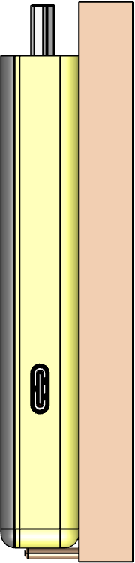
Datum Establishment
OMM Build Datum Alignment 3
Measurement equipment(测量设备): OMM
Clamping instructions(裝夾说明): 如(图1)所示
Magnification/ Lighting condition(倍率/光源): 2x / Ring Light
Datum Setup(基准建立):
1.按照下(图1)所示装夹产品, 并放置于设备平台上。
2.如图所示在产品表面对焦取点Z1, 在产品边缘取点P1~P3。
3.P1&P2构建线L1, 将L1旋转至Y轴, 设定Z1为Z轴原点, 设定L1为X轴原点, 设定P3为Y轴原点。
P3
P1, P2
P2
Z1
P1
(图1)
Notes:
14

Slide 15
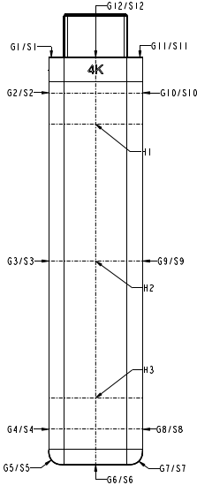
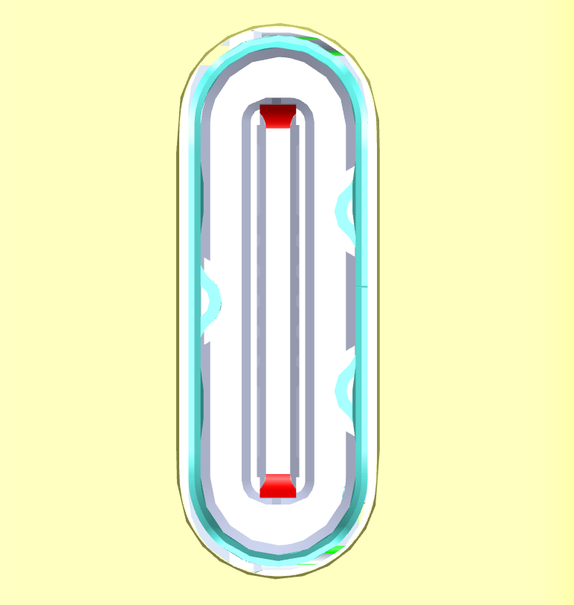
Measurement Description
No. | SPC Callout | Nominal | +Tol | -Tol | Measurement Method | Description | Fixture No. | Drawing Location | Remark
FAI08 |  | 0.05 | 0.10 | -0.05 | OMM | GAP | / |  | G7~G10
FAI09 |  | 0.35 | 0.20 | -0.20 | OMM | GAP | / |  | 2x
FAI10 |  | 0.35 | 0.20 | -0.20 | OMM | GAP | / |  | 2x
Measurement equipment(测量设备): OMM
Magnification/ Lighting condition(倍率/光源): 2x / Ring Light
Measurement Datum (测量基准): OMM Build Datum Alignment 3
Measurement description(测量描述):
1.1).按照(图1)所示,在G10(Y=-8.00mm)的位置, 取点P1, P2;
FAI08-G10：输出{P1&P2}的X向距离。
1.2).用相同方法测量G9, G8, G7的位置。
2.1).在(图2)所示的位置取点P3~P10;
FAI09-1 ：输出{P3&P4}的Y向距离。
FAI09-2 ：输出{P5&P6}的Y向距离。
FAI10-1 ：输出{P7&P8}的X向距离。
FAI10-2 ：输出{P9&P10}的X向距离。
P1
P2
G7~G10
G10
P3
P4
POS | Y
G7 | -90.00
G8 | -83.50
G9 | -45.75
G10 | -8.00
G9
P7
P8
P9
P10
G8
P5
G7
P6
(图1)
(图2)
Notes:
15

Slide 16
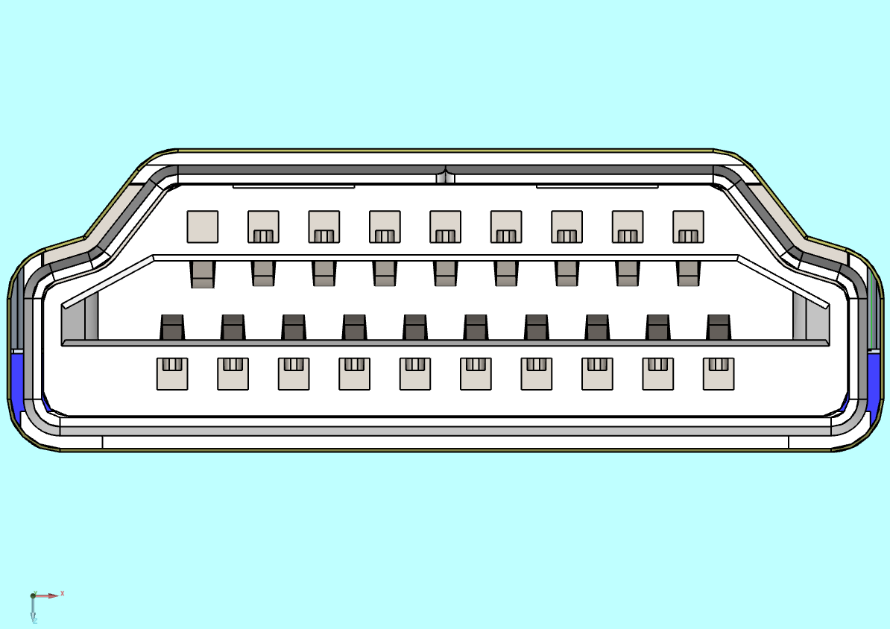
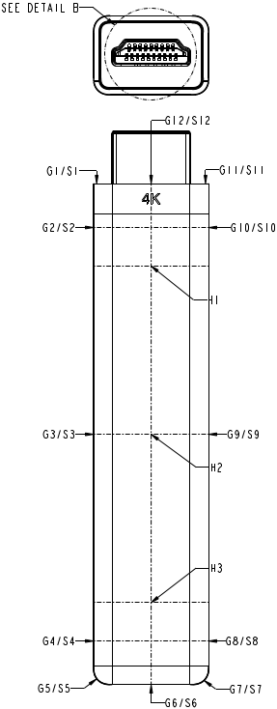
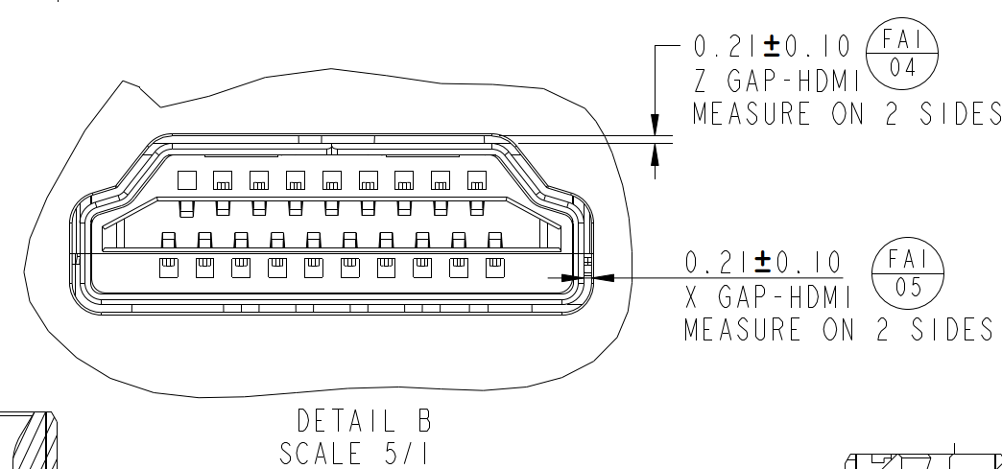
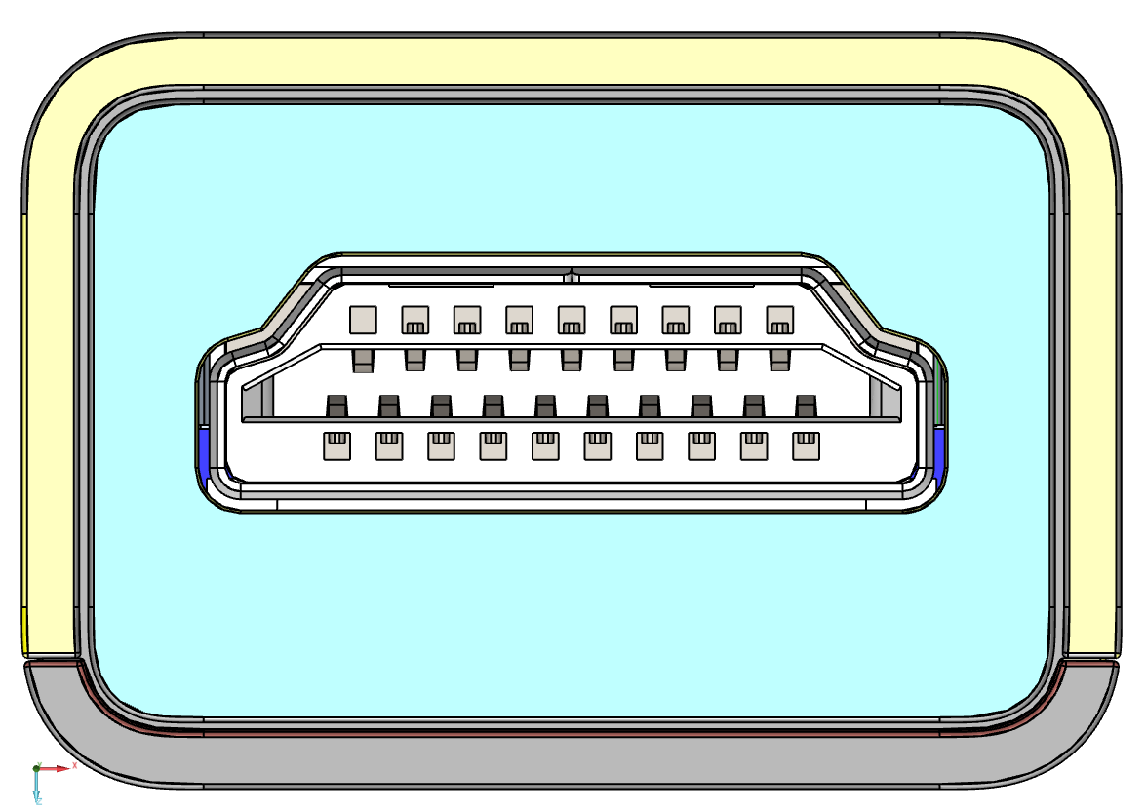
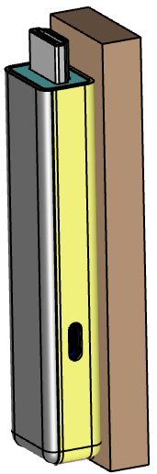
Datum Establishment
OMM Build Datum Alignment 4
Measurement equipment(测量设备): OMM
Clamping instructions(裝夾说明): 如(图1)所示裝夾
Magnification/ Lighting condition(倍率/光源): 2x / Ring Light
Datum Setup(基准建立):
1.按照(图1)所示竖立装夹产品并放于机台上, 在产品HDMI表面对焦测量平面PL1(Z1~Z4);
2.在产品边缘取点P1~P4。P2&P3构建线L1, P1&P4构建中点M1;
3. PL1摆正Z轴, 将L1旋转至X轴, 设定PL1为Z轴原点, M1为X轴原点, L1为Y轴原点。
Z1
Z2
P1
P4
Z3
P2
P3
Z4
(图1)
Notes:
16

Slide 17

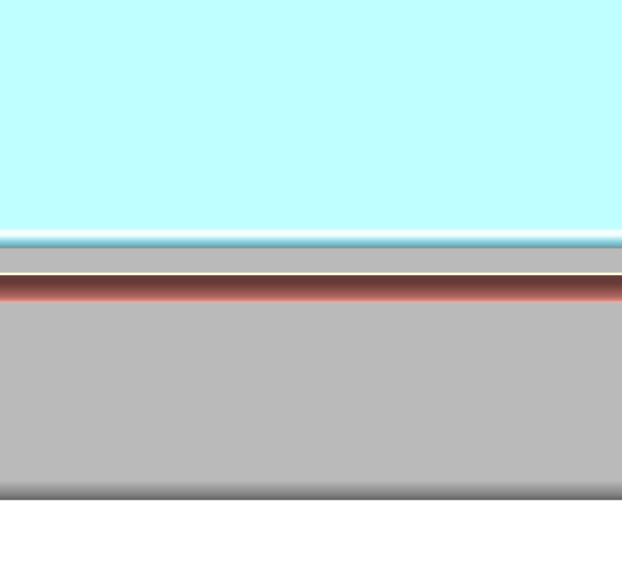
Measurement Description
No. | SPC Callout | Nominal | +Tol | -Tol | Measurement Method | Description | Fixture No. | Drawing Location | Remark
FAI04 |  | 0.21 | 0.10 | -0.10 | OMM | GAP | / |  | 2x
FAI05 |  | 0.21 | 0.10 | -0.10 | OMM | GAP | / |  | 2x
FAI08 |  | 0.05 | 0.10 | -0.05 | OMM | GAP | / |  | G12
Measurement equipment(测量设备): OMM
Magnification/ Lighting condition(倍率/光源): 2x / Ring Light
Measurement Datum (测量基准): OMM Build Datum Alignment 4
Measurement description(测量描述):
1).按右图所示, 取点P1~P8,
FAI04-1：输出{P1&P2}的Y向距离
FAI04-2：输出{P3&P4}的Y向距离
FAI05-1：输出{P5&P6}的X向距离
FAI05-2：输出{P7&P8}的X向距离
2).按右图所示, 取点P9, P10,
FAI08-G12 ：输出{P9&P10}的Y向距离
P1
ALL
P2
P5
P6
P7
P8
ALL
P3
P4
P9
P10
(图1)
G12
Notes:
17

Slide 18
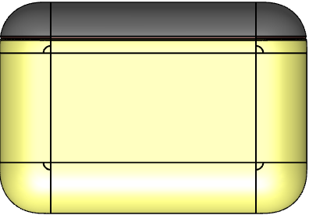
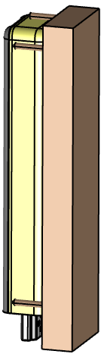
Datum Establishment & Measurement Description
No. | SPC Callout | Nominal | +Tol | -Tol | Measurement Method | Description | Fixture No. | Drawing Location | Remark
FAI08 |  | 0.05 | 0.10 | -0.05 | OMM | GAP | / |  | G6
/
Measurement equipment(测量设备): OMM
Magnification/ Lighting condition(倍率/光源): 2x / Ring Light
Measurement Datum (测量基准): 建立OMM基准5
1).按照(图1)所示竖立装夹产品, 并在产品上表面对焦取点Z1。
2).在产品边缘取点P1~P4。P2&P3构建线L1, P1&P4构建中点M1。L1旋转至X轴, 设定M1为X轴的原点, 设定L1为Y的原点, 设定Z1为Z的原点。
Measurement description(测量描述):
1).在OMM基准5下,取点P5, P6。
FAI08-G6 ：输出{P5&P6}的Y向距离。
P2
P3
P1
P4
Z1
P5
P6
G6取点位置
(图1)
Notes:
18

Slide 19
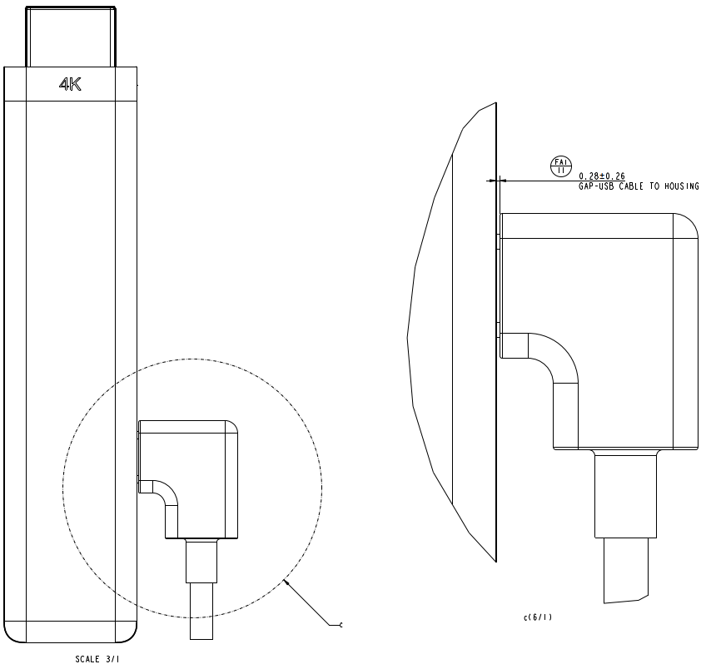
Datum Establishment & Measurement Description
No. | SPC Callout | Nominal | +Tol | -Tol | Measurement Method | Description | Fixture No. | Drawing Location | Remark
FAI11 |  | 0.28 | 0.26 | -0.26 | OMM | Distance | / |  | H1,H2,H3
/
Measurement equipment(测量设备): OMM
Magnification/ Lighting condition(倍率/光源): 2x / Ring Light
Measurement Datum (测量基准): 建立OMM基準6
1).按照右图所示, 先将数据线插入产品接口, 再平放机台上。在产品表面对焦测量點Z1, 在产品标示位置測量点P1~P3, P1&P2構建線L1。
2).L1旋轉至Y軸, 設置Z1為Z=0, 設置L1為X=0, 設置P1為Y=0。
Measurement description(测量描述):
在OMM基準6下：
1).如(图1)所示, 在产品上測量點P4, 在数据线上测量点P5。
2).FAI11 ：输出{P4&P5}的X向距离。
P3
P2
P4
P5
Z1
P1
Notes:
19

Slide 20
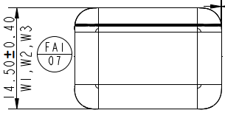
Datum Establishment & Measurement Description
No. | SPC Callout | Nominal | +Tol | -Tol | Measurement Method | Description | Fixture No. | Drawing Location | Remark
FAI07 |  | 14.50 | 0.40 | -0.40 | CMM | Height | / |  | W1,W2,W3
/
Measurement equipment(测量设备): CMM
Magnification/ Lighting condition(倍率/光源): /
Measurement Datum (测量基准): 建立CMM基準1
1).按照(图1)所示, 先将产品置於CMM幾台上, 在垫块的表面測量平面PL1(Z1~Z4)。
2).在产品标示位置測量點P1~P4, P3&P1構建線L1, P4&P2構建線L2, L1&L2再構建中線L3。
3).PL1摆正Z軸, 並設置PL1為Z=0; L3旋轉至Y軸, 設置L3為X=0, 設置P1為Y=0。
Measurement description(测量描述):
在CMM基準1下：
1).如(图1)所示, 在樣品上測量點H1~H3。
2).FAI07-W1:输出{H1&PL1}的Z向距离。
FAI07-W2:输出{H2&PL1}的Z向距离。
FAI07-W3:输出{H3&PL1}的Z向距离。
Z1
P1
Z2
P1
P2
H1
H2
POS | X | Y
H1 | 0 | -15.00
H2 | 0 | -45.75
H3 | 0 | -76.50
P3
H3
P4
Z3
Z4
(图1)
Notes:
20

Slide 21
End，thanks!

